Slide 1
Project 1: Speed Dating
Jonathan Bae, Haotian Li

Slide 2
Quick Glance
The objective of this study was to find what makes females decide yes to a male
Data given was from Kaggle (Anna Montoya) Speed Dating Experiment
We wish to give insight to males on how to get the most dates out of speed dating
Our findings show:
As a male, if you are attractive and funny, you will get the most yes

Slide 3
Assumptions
Dec_o indicates correctly whether or not the female partner says yes or no
Field_cd maps to the correct field
Focus on men’s attributes only
Only things a man can control
Not enough information to impute mn_sat, tuition, or income

Slide 4
Data Cleaning
The attributes used are
Imputation:
For na rating for a single attribute value (attr_o, sinc_o, intel_o, fun_o, amb_o) from partners, use mean score of the iid
Na coding for field_cd or career_c, code to value of similar corresponding careers and fields
Remove rows where no age or date preference values per iid
Change met values to either 1 (met previously) or 2 (have not previously)

Slide 5
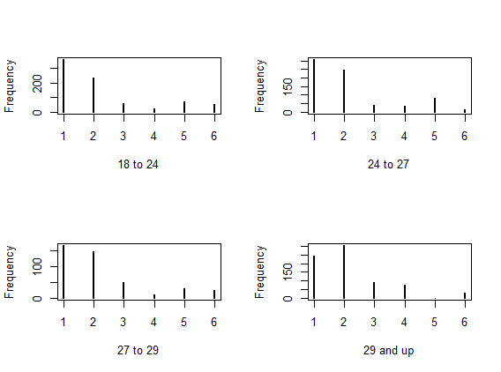
Daters reasons they go change
We see an increase in goal 4 which is “Looking for a serious relationship” as age increases
Bins created based on quantiles of boxplot

Slide 6
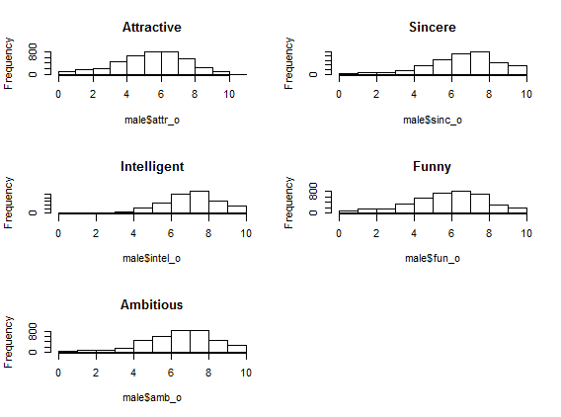
Ratings may be biased
Sincere, Intelligent, Funny, and Ambitious have similar distributions whereas Attractive seems more representative of the ways humans will rate people

Slide 7
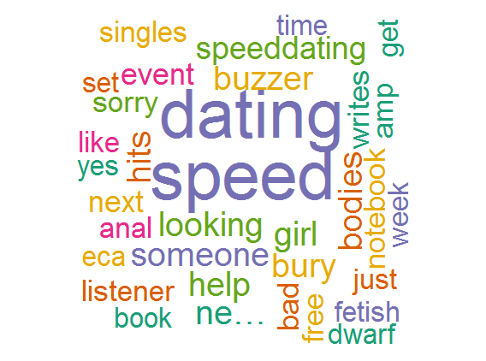
Sentiment Analysis
No results for “Speed Dating” in either Charlottesville or Manhattan
Word cloud for speed dating in general

Slide 8
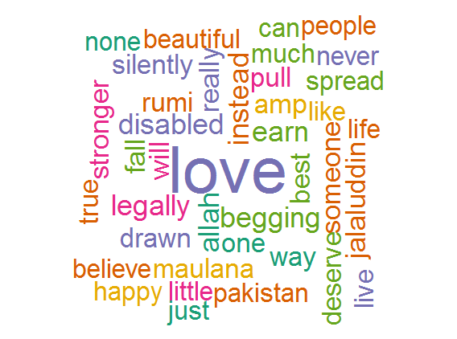
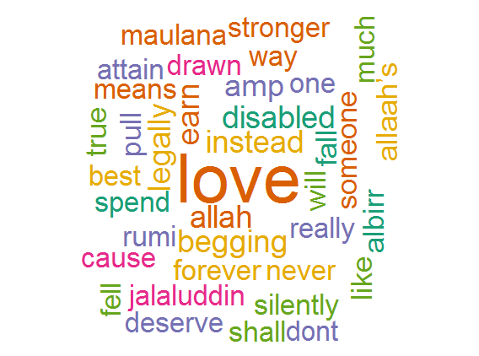
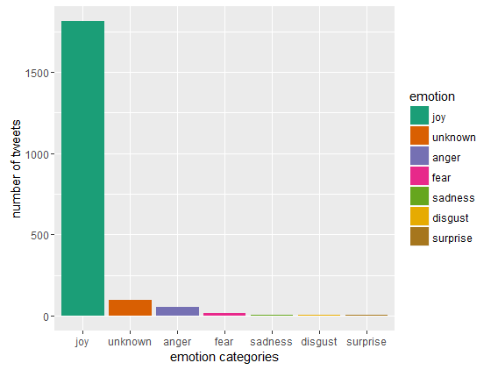
Love and Romance
A few word clouds for the word “Love”
Some unique words are seen (such as allah and disabled)
We also see that many of these tweets have joy as the emotion
Left: Charlottesville, Right: Manhattan

Slide 9
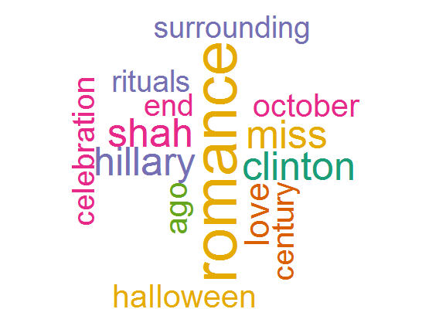
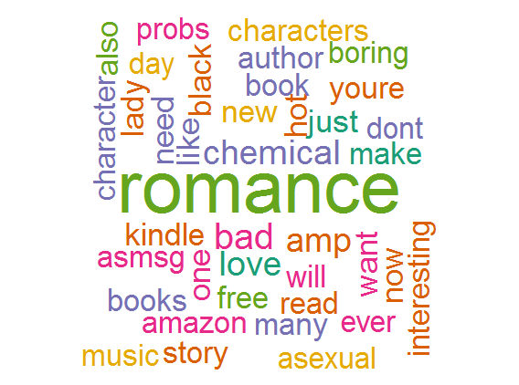
A few word clouds for the word “Romance”
Everywhere is focused more on book results
Left: Charlottesville, Right: Everywhere

Slide 10
Classification

Slide 11
Classification
Attractiveness and funniness always matter
Field and sincerity matter when you are attractive

Slide 12
Conclusion
Further Study:
Correlations between ratings and other attributes
Include education and income measurement

